Slide 1
Hotel Management System Project Report in PHP PPT

Slide 2
INTRODUCTION
HOTEL MANAGEMENT SYSTEM is a hotel reservation site script where site users will be able to search rooms availability with an online booking reservations system. Site users can also browse hotels, view room inventory, check availability, and book reservations in real-time.
Site users enter check in date and check out date then search for availability and rates. After choosing the right room in the wanted hotel – all booking and reservation process is done on the site and an SMS is sent to confirm the booking.

Slide 3
Purpose
This proposes that efficiency of hotel organizations could be improved by integrating service-oriented operations service-oriented operations with project management principles. Such integration would instill innovation, proactive attitudes and regulated risk-taking needed to pursue ongoing improvement and proactive response to change. By managing each change as a project, embedded in smoothly running operations, hotels would extend their life span by continuously reinventing themselves.

Slide 4
Advantages:
The advantages of booking a hotel online add up long before your arrival. Our legendary customer service extends to the web
One advantage of booking with the hotel directly is the use of the hotel's full cancellation policy as well as not needing a deposit in most situations.
Read reviews and compare prices for Online Hotel Booking.
The most important advantage of online hotel booking is convenience, you can book your room by simply sitting in home. Internet helps you to browse through the hotels around the world and compare the facilities and rates easily

Slide 5
Software requirement Specification
A set of programs associated with the operation of a computer is called software. Software is the part of the computer system, which enables the user to interact with several physical hardware devices.
The minimum software requirement specifications for developing this project are as follows:
Operating System : Windows XP/Vista/2000, Linux.
Presentation layer : PHP, CSS, HTML, JSP, FLASH
Database : My SQL
Presentation : Power Point 2003
Documentation Tool : Ms Office
For sending SMS, we need the SMS API and a gateway.

Slide 6
Module Description
The HOTEL MANAGEMENT SYSTEM consists of 2 modules and 5 categories.
The categories are as follows:
Advanced Search
Car Hire
Booking
Payment
SMS Integration
The modules are
Administrator
User
Admin Module:
The Functionalities of the Administrator is:
The administrator should login into the system with unique his/her password and username.
If the username and password is validated then he can gain access to the system.
View the hotels can update and delete the hotels.
Post the special offers, add new hotel to the hotels list.
Insert /View the Availability and Price.
Post the links. Adding the links to the hotels and as well view the links.
Blocks the user view the status of the users.
Restrict the user to the see the more information with out login.

Slide 7
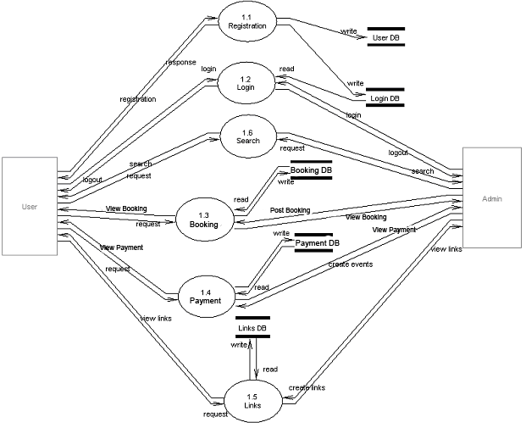
Top Level DFD

Slide 8
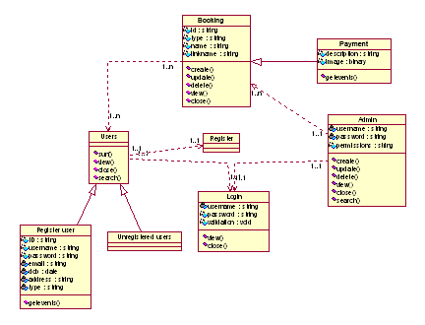
Class Diagrams

Slide 9
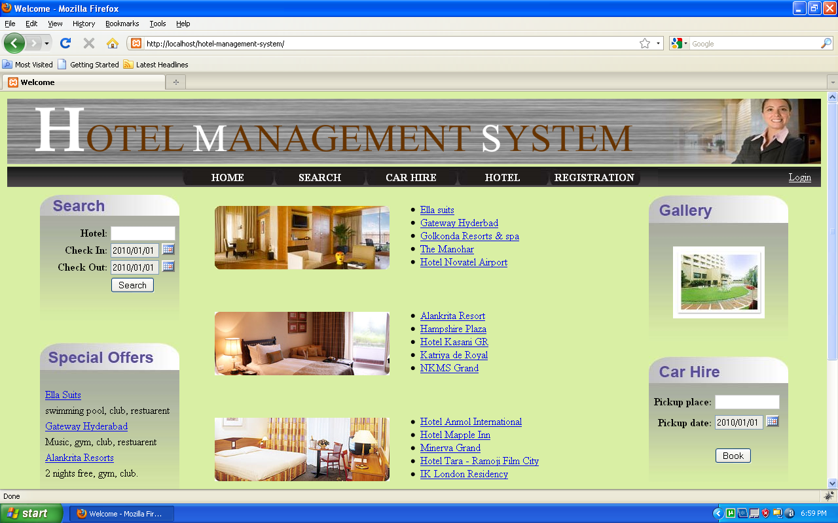

Slide 10
